Slide 1
Unit 4
Lecture 4

Slide 2
Some basic compression methods:
Huffman coding
Golomb coding
Arithmetic coding
Lempel-Ziv-Welch (LZW) coding
Run Length coding
Symbol based coding
Bit plane coding
Block transform coding
Predictive coding
Wavelet coding

Slide 3
LZW algorithm
Lossless compression
Rely on reoccurring patterns to save data space
Example: Encode the string “thisisthe”
In uncompressed ASCII this string is equivalent to
0111010001…………………………………………….. Long string
116 104 105 115 105 115 116 104 101
This is 72 bits (9*8 bits) long, we will have to compress it using LZW
Has the concept of a dictionary where you store your strings

Slide 4
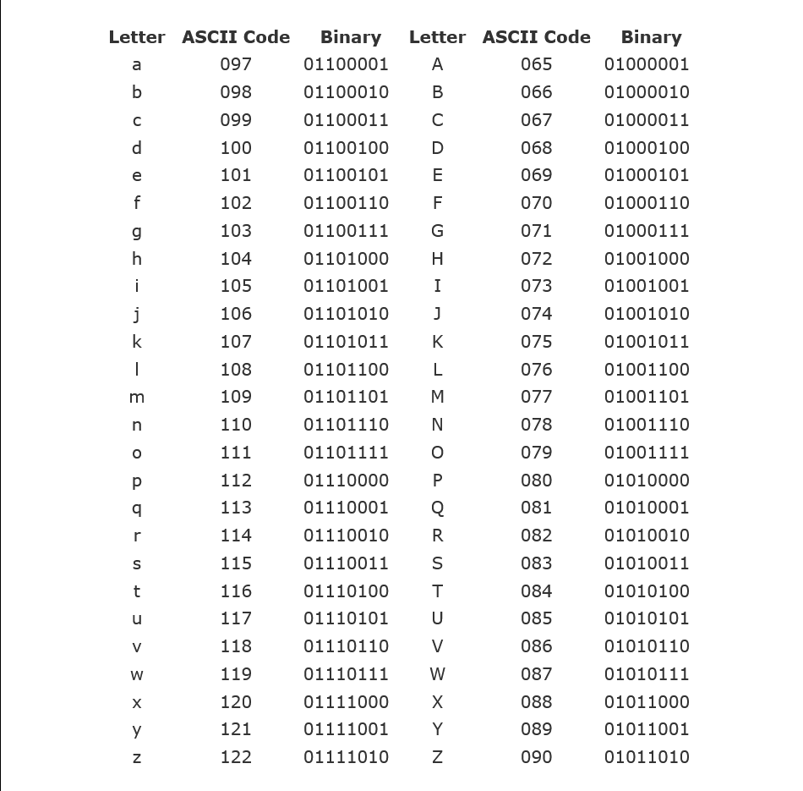

Slide 5
Step 1: start adding pairs of symbols to the dictionary of words
Step 2: when we reach a pair that is already available in the dictionary, replace that pair with the new dictionary value.
“thisisthe”
Current | Next | Output | Dictionary | Explanation
t (116) | h(104) | t(116) | th(256) | th not in dictionary so output t and add th to dictionary
h(104) | i(105) | h(104) | hi(257)
i(105) | s(115) | i(105) | is(258)
s(115) | i(105) | s(115) | si(259)
i(105) | s(115) | is(258) | ist(260) | “is” already in the dictionary, so check if “ist “ is in the dictionary
t(116) | h(104) | th(256) | the(261) | “th” already in the dictionary, so check if “the “ is in the dictionary
e(101) | - | e(101) | -

Slide 6
Decompress the code 116 104 105 115 258 256 101
Output: 116 104 105 115 105 115 116 104 101
“t h i s i s t h e “
Current | Next | Output | Dictionary | Explanation
116 | 104 | 116 | 116 104 (256) | 116 104 not in dictionary so output 116 and add 104 to dictionary
104 | 105 | 104 | 104 105(257)
105 | 115 | 105 | 105 115(258)
115 | 258 | 115 | 115 105 115 (259) | 258 outside ASCII value so add 105 115 instead
258 | 256 | 105 115 | 105 115 116(260) | “105 115” not in the dictionary, so add 105 115 and the first value of 256 which is 116. dictionary is made with combining one character at a time.so we should add only the first symbol to the current combination when rebuilding the dictionary. Serious problem when dealing with bigger strings.
256 | 101 | 116 104 | 116 104 101(261)
101 | - | 101 | -

Slide 7
“thisisastring” 13*8=104
12*9=96 96/104 =92.3% Reason for less compression: repeated patterns less
Current | Next | Output | Dictionary | Explanation
t (116) | h(104) | t(116) | th(256) | th not in dictionary so output t and add th to dictionary
h(104) | i(105) | h(104) | hi(257)
i(105) | s(115) | i(105) | is(258)
s(115) | i(105) | s(115) | si(259)
i(105) | s(115) | is(258) | isa(260) | “is” already in the dictionary, so check if “isa “ is in the dictionary
a(97) | s(115) | a(97) | as(261)
s(115) | t (116) | s(115) | st(262)
t (116) | r(114) | t (116) | tr(263)
r(114) | i(105) | r(114) | ri(264)
i(105) | n(110) | i(105) | in(265)
n(110) | g(103) | n(110) | ng(266)
g(103) | - | g(103) | -

Slide 8
116 104 105 115 258 97 115 116 114 105 110 103
Current | Next | Output | Dictionary | Explanation
116 | 104 | 116 (t) | 116 104(256)
104 | 105 | 104 (h) | 104 105(257)
105 | 115 | 105 (i) | 105 115(258)
115 | 258 | 115(s) | 115 105(259)
258 | 97 | 105 115 (is) | 105 115 97(260)
97 | 115 | 97 (a) | 97 115(261)
115 | 116 | 115 (s) | 115 116(262)
116 | 114 | 116 (t) | 116 114(263)
114 | 105 | 114 (r) | 114 105 (264)
105 | 110 | 105 (i) | 105 110(265)
110 | 103 | 110 (n) | 110 103(266)
103 | - | 103 (g) | -

